Slide 1
Exploring Customer Booking Patterns
Unveiling Trends in Purchase Lead Time, Trip Types, and Sales Channels for Incomplete and Completed Flight Bookings

Slide 2
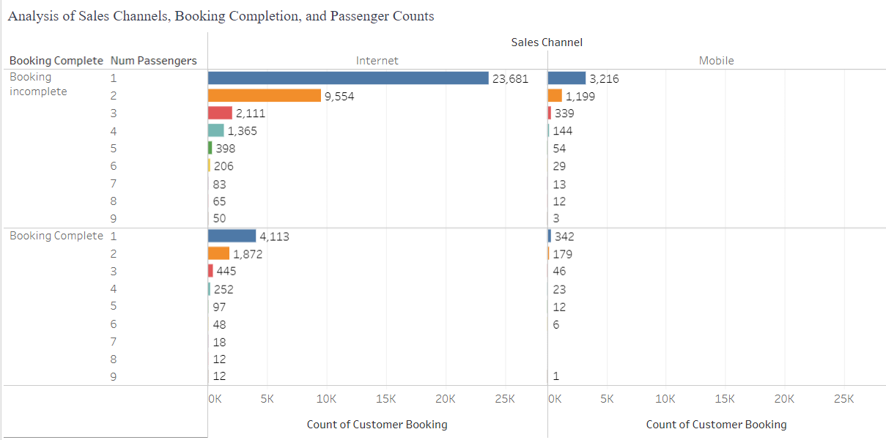
Insights from Passenger Preferences and Booking Patterns
The analysis revealed 42,522 instances of incomplete bookings with a booking completion flag of 0 and 7,478 instances of completed bookings with a flag of 1.
The study found that round trips have a higher completion rate, while circle trips(less common choice among customers.) and one-way trips have low completion rates.
The data indicates that the internet is the primary booking platform, with higher completion rates, while mobile bookings contribute but have lower completion rates and higher abandonment.
Bookings with fewer passengers show higher completion rates, suggesting quicker decision-making, while larger groups (5-9 passengers) experience more abandonment due to complex coordination and decision challenges.
Purchase lead time affects completed bookings stability, with short lead times causing higher incompletions and longer lead times resulting in more completions.

